Slide 1

Module 1:Introduction to Cloud Computing

Slide 2
Content
Introduction
Basic Concepts
Cloud Models and Services
Cloud Characteristics
Cloud Benefits and disadvantages

Slide 3
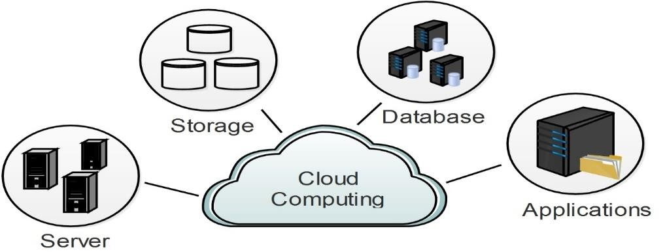
Cloud Computing
The term cloud refers to a network or the Internet. It is a technology that uses remote servers (present in data center) to store, manage, and access data online rather than local drives.
“Cloud computing” is a on-demand Internet based computing, where different services including servers, storage and applications are delivered to the user through the Internet on a pay-per-use basis.

Slide 4
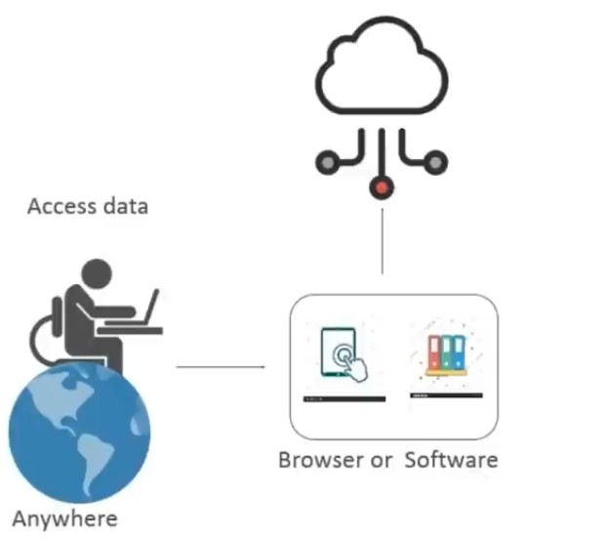
What is cloud ?
Cloud computing is:
Storing data/Applications on remote servers
Processing data/Applications from servers
Accessing data/Application via Internet.

Slide 5
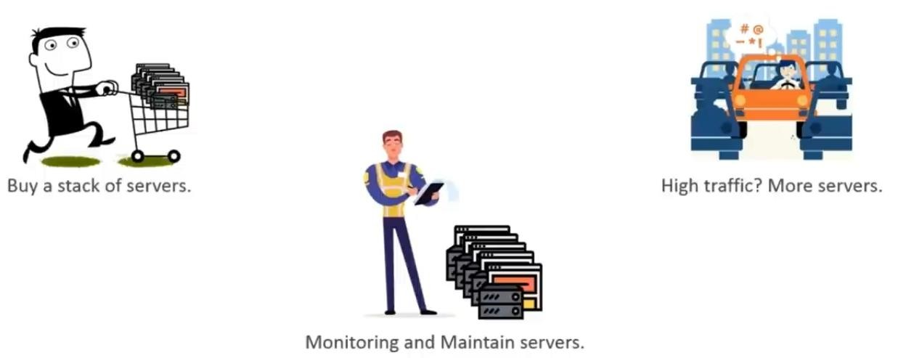
Before cloud
Suppose we want to host a website; there are the following things that we would need to do:

Slide 6
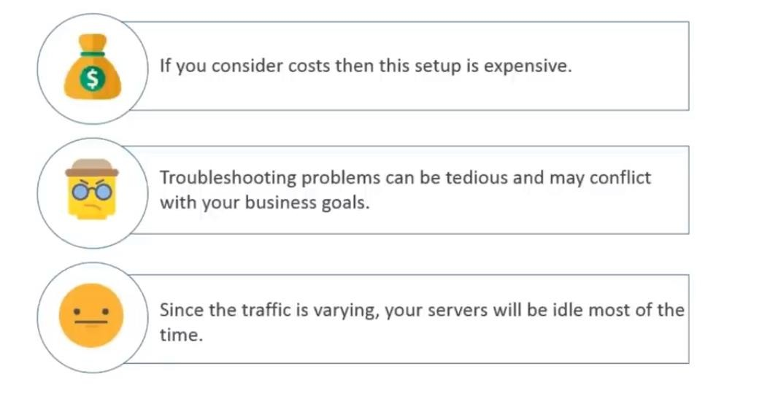
Disadvantages

Slide 7
Cloud Computing
AWS: Cloud computing is the on-demand delivery of compute power, database, storage, applications, and other IT resources via the internet with pay-as-you-go pricing.
IBM: Cloud computing, often referred to as simply “the cloud,” is the delivery of on-demand computing resources—everything from applications to data centers—over the Internet on a pay-for- use basis.
Webopedia: Cloud computing is typically defined as a type of computing that relies on sharing computing resources rather than having local servers or personal devices to handle applications.

Slide 8
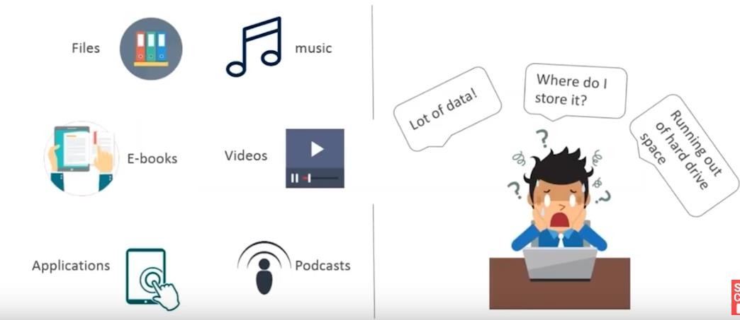
Why Cloud?
Huge Amount of digital data

Slide 9
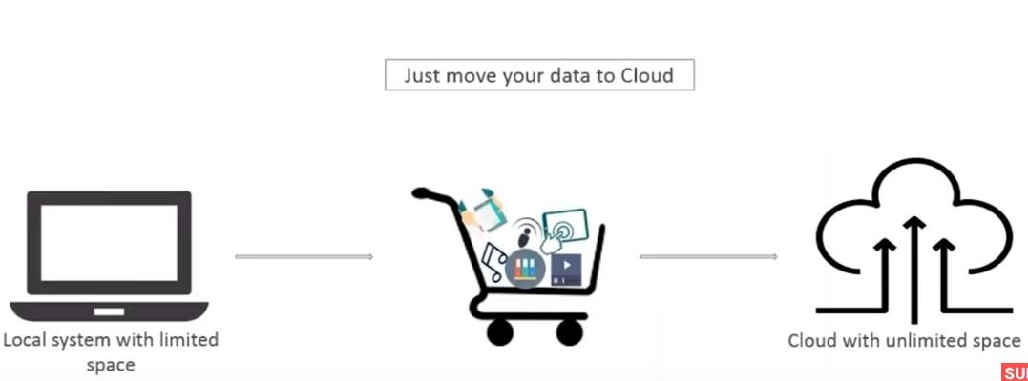
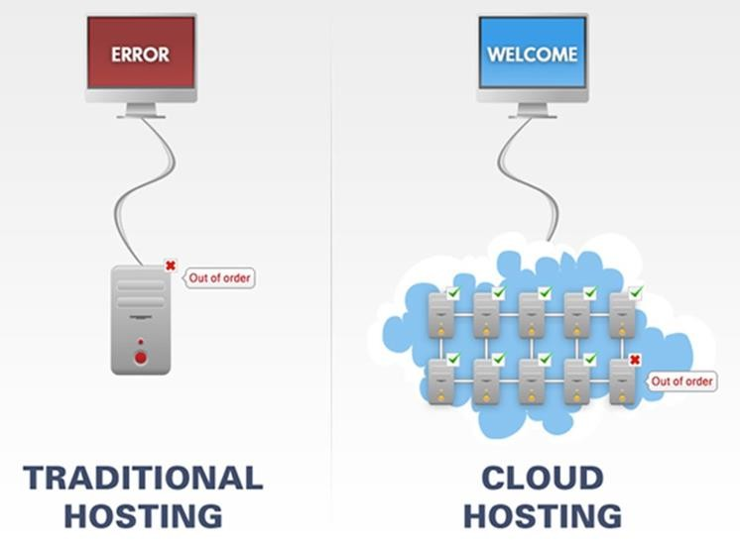
Why Cloud?
Solution: Move to Cloud

Slide 10
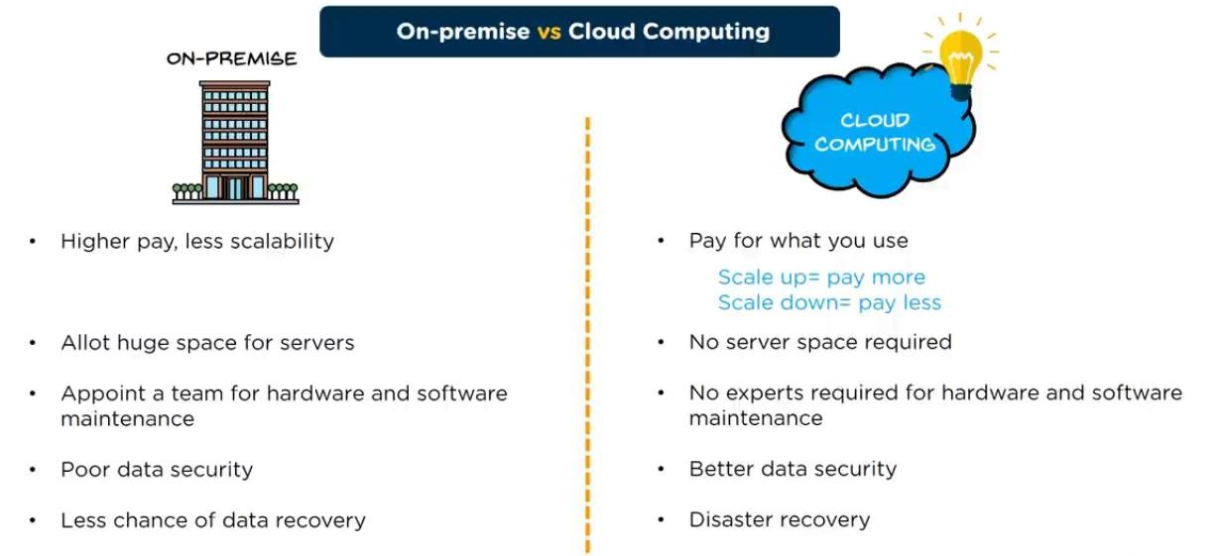
On-Premise Vs Cloud Computing

Slide 11
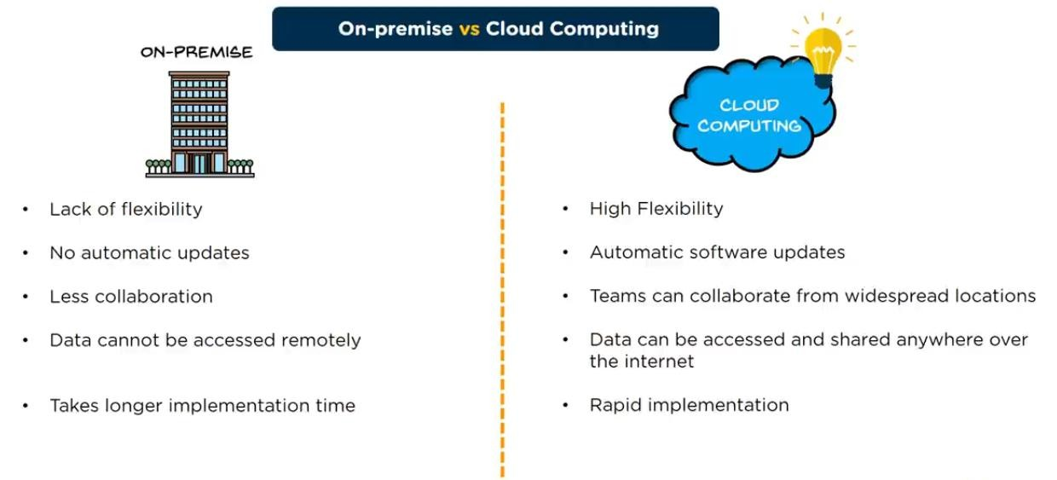
On-Premise Vs Cloud Computing

Slide 12
Cloud Computing Terminologies
Cloud Service Provider (CSP): A company that provides a cloud-based platform, infrastructure, application or storage services, usually for a fee. Popular CSPs Amazon Web Services (AWS), Microsoft Azure, Google Cloud, IBM Cloud etc.
Data Center : A data center is a building (or self-contained unit within a building) used to house cloud computing equipment such as servers along with associated components such as telecommunications, network and storage systems.
Cloud Backup : Cloud backup is the process of backing up data to a remote, cloud-based server.

Slide 13
Cloud Computing Terminologies
Cloud Broker : An entity that manages the use, performance and delivery of cloud services, and negotiates relationships between Cloud Providers and Cloud Consumers. Example: AWS Marketplace from Amazon.com
Service Level Agreement (SLA) – A service level agreement (SLA) is a contractual agreement between a customer and a cloud service provider (CSP) which defines the level of service, availability and performance guaranteed by the CSP.
Content Delivery Network (CDN) – A content delivery network (CDN) is a network of distributed services that deliver content to a user based on the user’s geographic proximity to servers.

Slide 14
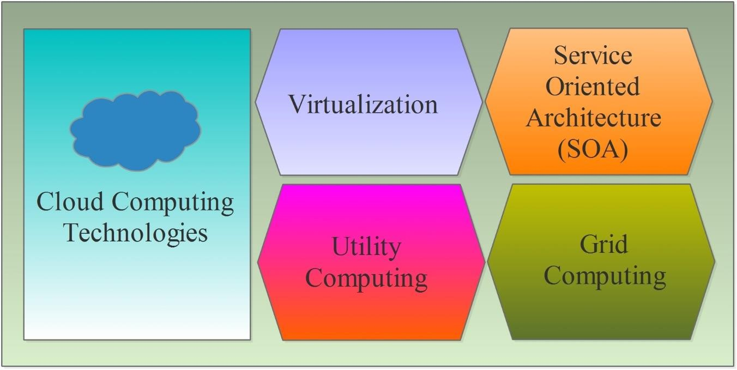
Cloud Computing Technologies

Slide 15
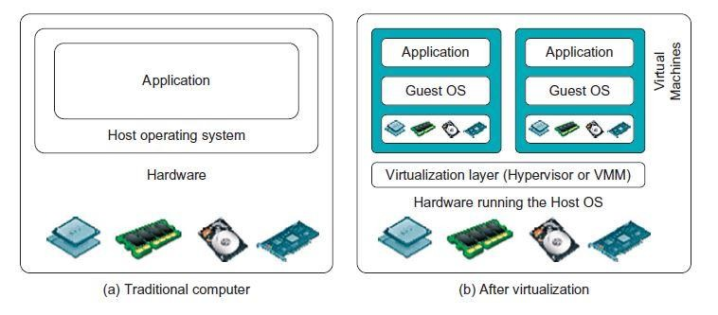
Virtualization
Virtualization is a partitioning of single physical server into multiple logical servers.
It involves using specialized software called as Virtual Machine Monitor (VMM) or hypervisor, to create a virtual or software-created version of a computing resource.

Slide 16

Service-Oriented Architecture (SOA)
SOA is an application framework which takes everyday business applications and divides them into separate business functions and processes called Services.
Service-Oriented Architecture (SOA) allows organizations to access on- demand cloud-based computing solutions according to the change of business needs.

Slide 17
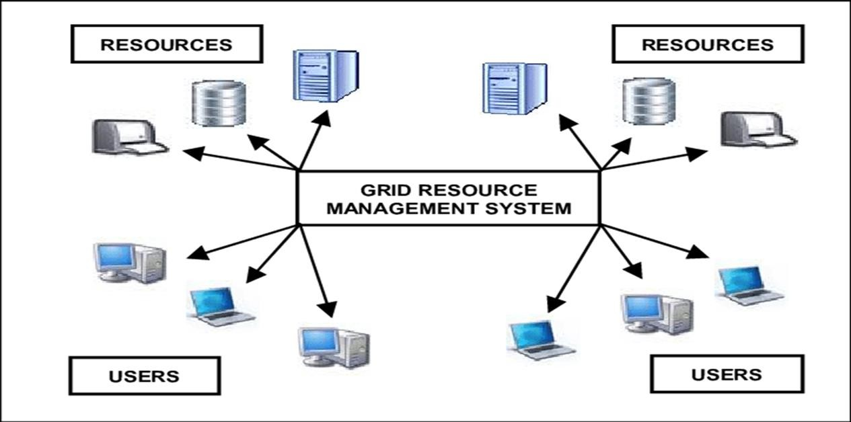
Grid Computing
Grid computing is the structure of distributed computing, in which a group of computer resources from various locations are connected to each other to obtain a common objective.

Slide 18
Utility Computing
Utility computing is based on Pay-per-Use model.
It provides computational resources on demand service.
The advantage of utility computing is that it reduced the IT cost, provides greater flexibility, and easier to manage.

Slide 19
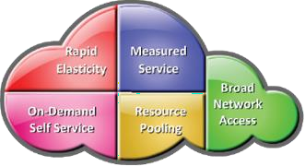
NIST Cloud Computing
Cloud computing is a model for enabling ubiquitous, convenient, on-demand network access to a shared pool of configurable computing resources (e.g., networks, servers, storage, applications and services) that can be rapidly provisioned and released with minimal management effort or service provider interaction.
Essential Cloud characteristics
On-demand self-service
Broad network access
Resource pooling
Rapid elasticity
Measured service

Slide 20
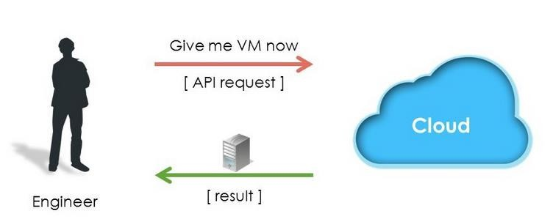
On-Demand Self-Service
Cloud computing resources can be provisioned without human interaction from the service provider.
Enables consumers to unilaterally provision computing capabilities (examples: server time and storage capacity) as needed automatically.
Consumers view service catalogue via a Web-based user interface and use it to request for a service.

Slide 21
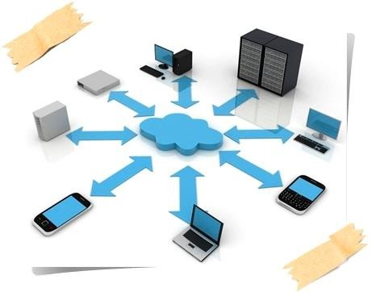
Broad Network Access
Computing capabilities are available over the network and accessed from a broad range of client platforms such as:
  Desktop computer
  Laptop
  Tablet
  Mobile device

Slide 22
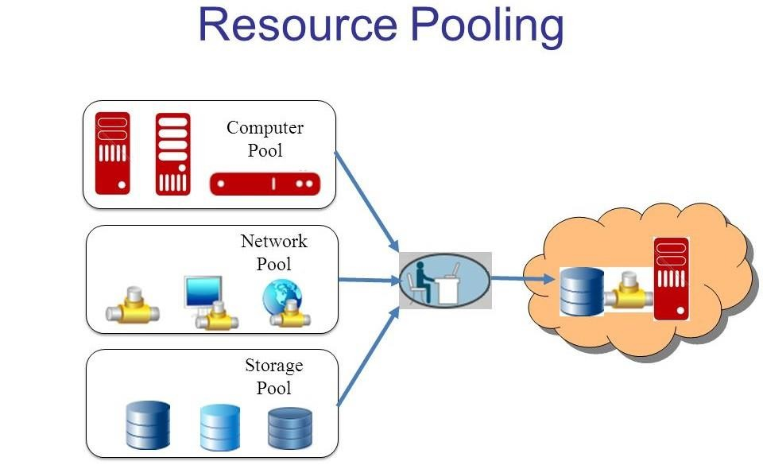
Resource Pooling
The provider’s computing resources are pooled to serve multiple consumers using a multi-tenant model, with different physical and virtual resources dynamically assigned and reassigned according to consumer demand.
Multi-tenancy allows multiple customers to share the same applications or the same physical infrastructure while retaining privacy and security over their information.
Consumers have no control or knowledge over the exact location of the provided resources.

Slide 23
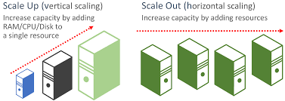
Rapid Elasticity
Scalable provisioning, or the ability to provide scalable services.
The Computing services should have IT resources that are able to
scale out and in quickly and on as needed basis.
Scale Down : removal of existing resources from existing servers such as CPU, memory, and disks.
Scale in : process of removing existing servers.

Slide 24
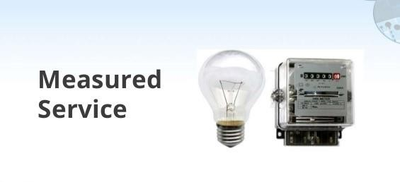
Measured Service
Cloud computing provides a metering system that continuously monitors resource consumption and generates reports.
  Helps to control and optimize resource use
  Helps to generate billing on a Pay-per-use model basis as a metered

Slide 25
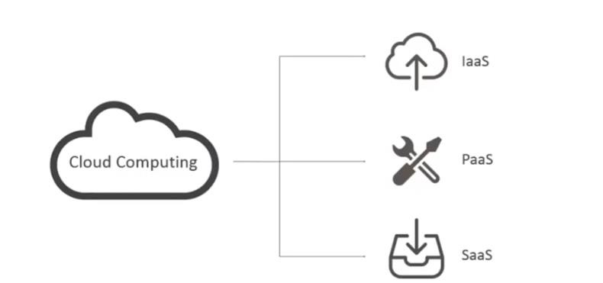
Shared Responsibility Model
On-Premises (Traditional IT)
IaaS Model Responsibility
PaaS Model Responsibility
SaaS model Responsibility

Slide 26
Cloud Service/Delivery Model
Infrastructure as a Service (IaaS)
Platform as a Service (PaaS)
Software as Service (SaaS)
Container as a Service (CaaS)
Function as a Service (FaaS- Serverless)
Anything as a Service (XaaS)

Slide 27
Cloud Service /Delivery Model
A model for enabling ubiquitous, convenient, and on-demand network access to a shared pool of resources.
According to the abstraction level of the capability provided by the CSP three types of service models are used.

Slide 28
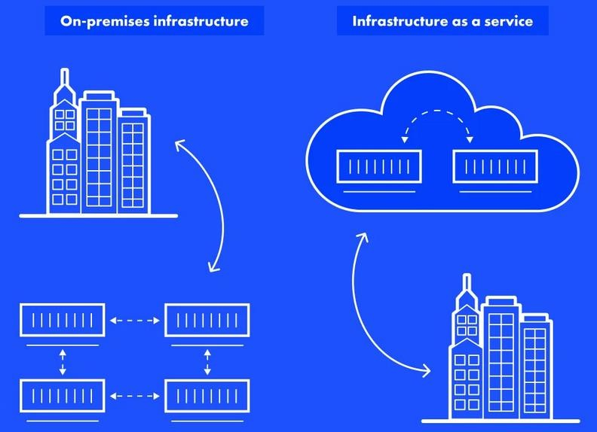
Infrastructure as a Service (IaaS)

Slide 29
Infrastructure as Service (IaaS)
IaaS is also known as Hardware as a Service (HaaS).
Computing resources such as processing power, memory, storage, and networking components are offered as service.
Consumers have control over the OSs and deployed applications.
IaaS platforms are: Highly flexible and highly scalable, Accessible by multiple users, Cost-effective.
Who uses?:
Businesses who are looking for cutting cost on IT infrastructure, IaaS is one of the solutions.

Slide 30
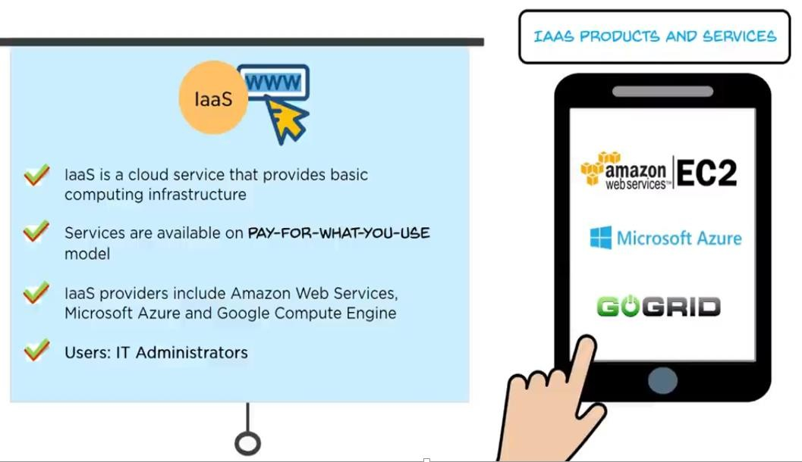
Infrastructure as Service (IaaS)

Slide 31
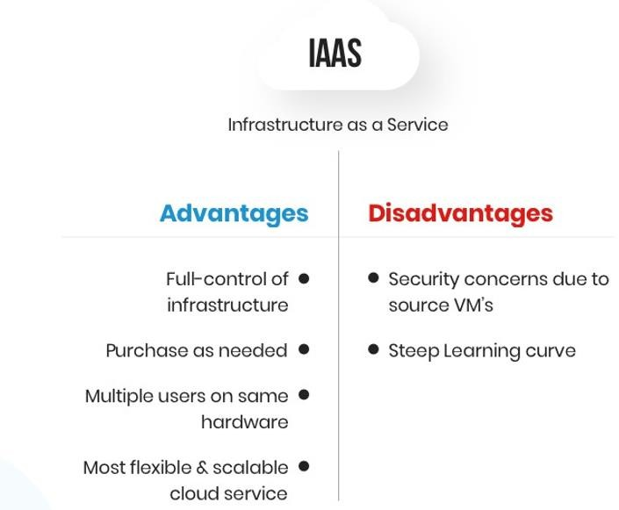
Infrastructure as a Service (IaaS)
Advantage and Disadvantage of IaaS
Steep learning curve- Companies need to train their workforce in order to effectively manage the infrastructure.

Slide 32
Platform as a Service (PaaS)
A PaaS vendor provides hardware and software tools (Computing platform is offered as a service) over the internet, and people use these tools to develop applications.
PaaS cloud computing platform is created for the programmer to develop, test, run, and manage the applications.
PaaS allows the developer to focus on the creative side of app development, as opposed to tedious tasks such as managing software updates or security patches.
Consumer has control over deployed applications.
Who uses?:
Businesses who want to create unique applications without spending a fortune or taking on all the responsibility.

Slide 33
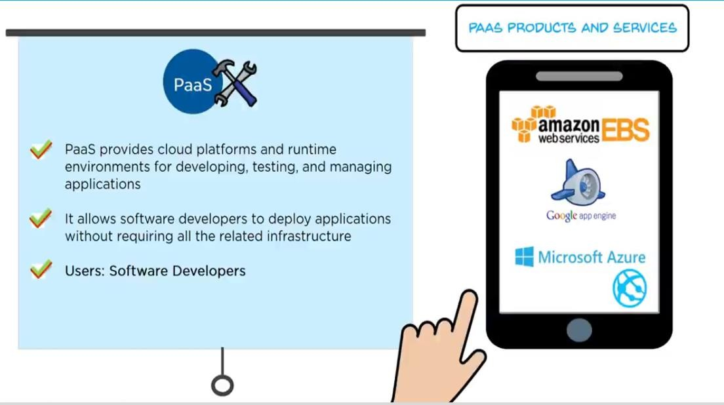
Platform as a Service (PaaS)

Slide 34
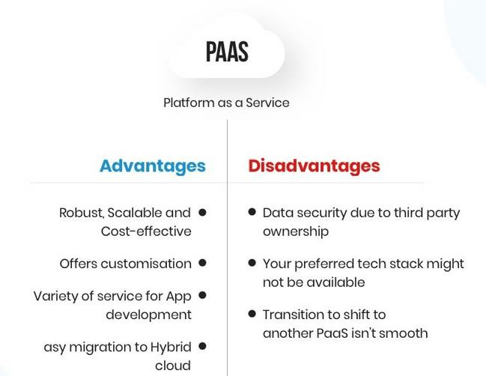
Platform as a Service (PaaS)
Advantage and Disadvantage of PaaS

Slide 35
Software as a Service (SaaS)
SaaS platforms make software available to users over the Internet, usually for a monthly subscription fee.
Most subscriptions include maintenance, compliance, and security services, which can be time-consuming and costly when using on premise software.
Service providers exclusively manage computing infrastructure and software to support services
Who uses?:
Anyone who needs access to a particular piece of software can be subscribed as a user.

Slide 36
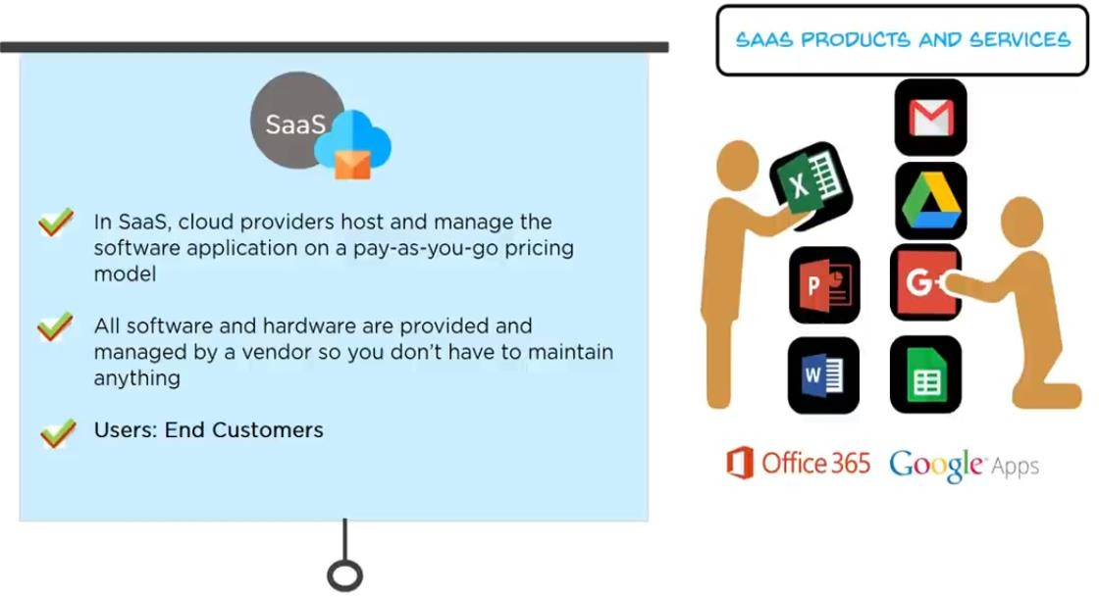
Software as a Service (SaaS)

Slide 37
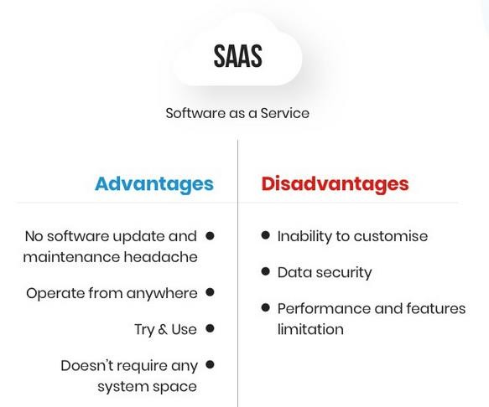
Software as a Service (SaaS)
Advantage and Disadvantage of SaaS

Slide 38
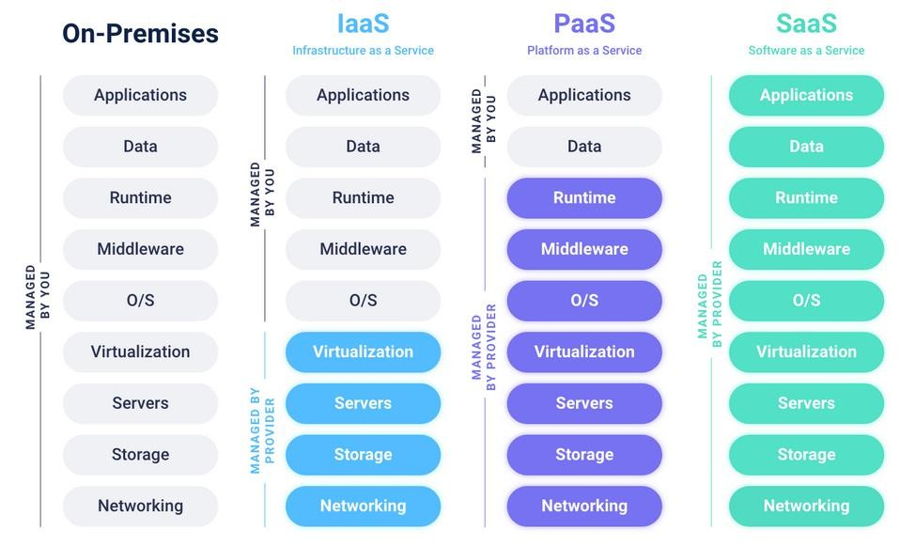
Cloud Shared Responsibility Model

Slide 39
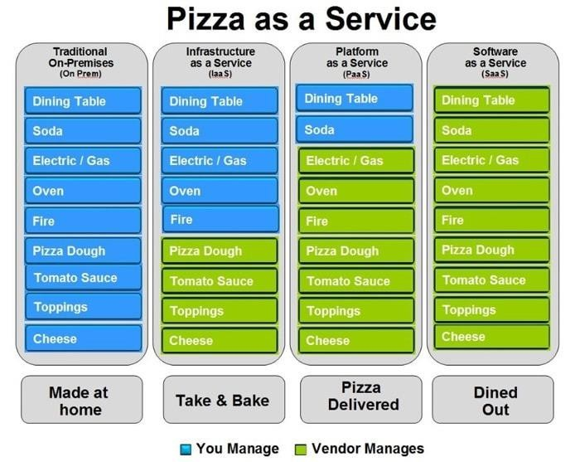
Mapping with Real life
Exapmle1: on premise, IaaS, PaaS, SaaS

Slide 40
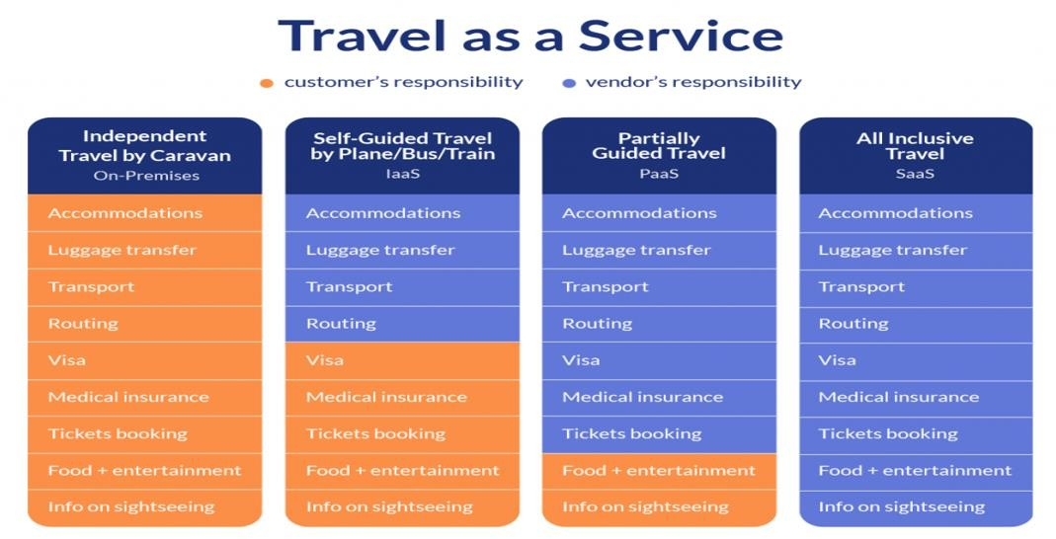
Mapping with Real Life
Exapmle2: on premise, IaaS, PaaS, SaaS

Slide 41
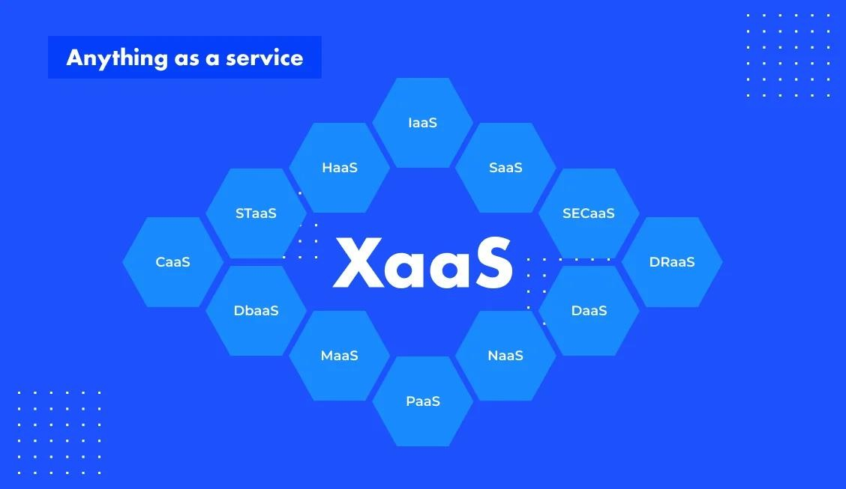
Anything as a Service (XaaS)

Slide 42
Anything as a Service (XaaS)
‘X’ stands for ‘anything’. So, XaaS is ‘anything as a service’. XaaS is also known as “Everything-as-a-Service”.
It is a term that refers to any tools, applications, services, games, etc., delivered to your laptop or other devices via the cloud.

Slide 43
Anything as a Service (XaaS)
Most common types of XaaS include:
  Software as a Service (SaaS)
  Platform as a Service (PaaS)
  Infrastructure as a Service (IaaS)
  Storage as a Service (STaaS)
  Disaster Recovery as a Service (DRaaS)
  Communications as a Service (CaaS)
  Network as a Service (NaaS)
  Data as a Service (DaaS)

Slide 44
Cloud Deployment Models
1. Public Cloud
2. Private Cloud
3. Hybrid Cloud
4. Community Cloud
5. Multi-Cloud

Slide 45
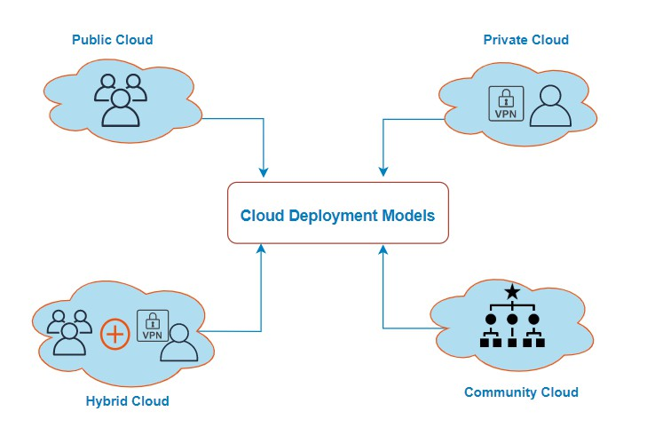
Cloud Deployment Models
A Cloud Computing deployment model is a model that describes the environment where cloud applications and services can be installed, in order to be available to consumers.
The deployment environment means the physical location, the infrastructure facilities, the platform constraints, as well as anything that can affect the access mechanisms of the deployed applications.

Slide 46
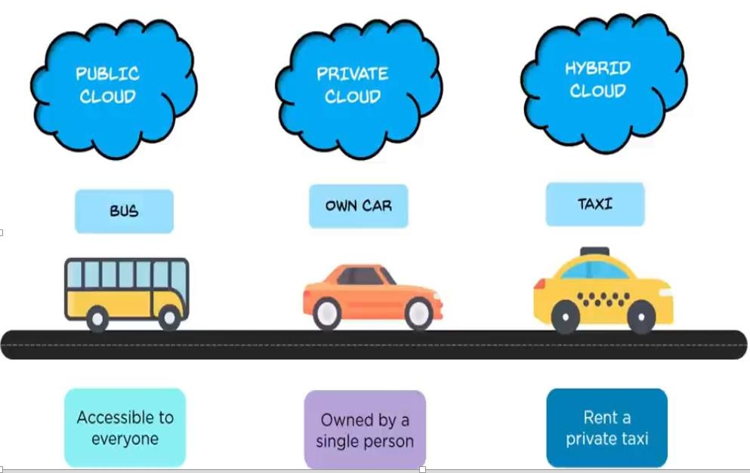
Cloud Deployment Models

Slide 47
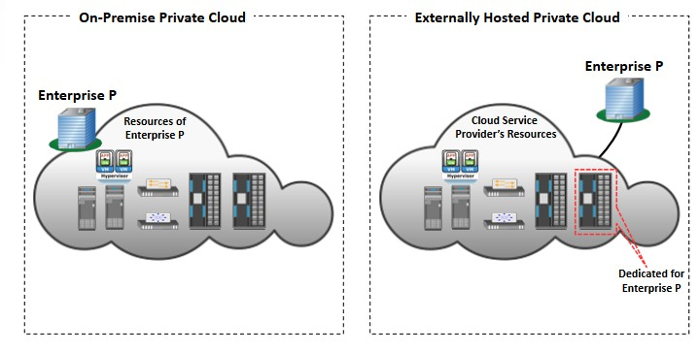
Private Cloud
A private cloud is a cloud service that is exclusively offered to one organization.
A private cloud can either be inside an organization or remotely managed by a third party and accessed over the Internet (but it is not shared with anyone).

Slide 48
Private Cloud
A hosted private cloud is off-premises instead of on-premises, meaning the cloud servers are not physically located on the grounds of the organization using them. A third party manages and hosts the cloud remotely. (off-premise)
An internal private cloud is hosted on an organization's own premises, and is managed by them internally.(on-premise)
Example:- Suppose a large company A in Delhi wants to run a private cloud.
They can either set up an internal private cloud in their Delhi office building. (internal)
They can let a third-party cloud provider host their private cloud. That third party may be in a different area of Delhi, or in another city, or even another state. (hosted)

Slide 49
Advantages of Private Cloud
More control: Private clouds have more control over their resources and hardware than public clouds because it is only accessed by selected users.
Security & privacy: Security & privacy are one of the big advantages of cloud computing. Private cloud improved the security level as compared to the public cloud.
Improved performance: Private cloud offers better performance with improved speed and space capacity.

Slide 50
Disadvantages of Private Cloud
High cost: The cost is higher than a public cloud because set up and maintain hardware resources are costly.
Restricted area of operations: As we know, private cloud is accessible within the organization, so the area of operations is limited.
Limited scalability: Private clouds are scaled only within the capacity of internal hosted resources.
Skilled people: Skilled people are required to manage and operate cloud services.

Slide 51
Public Cloud
A public cloud or external cloud is a model, in which the infrastructure facilities are provided by a third party (the cloud providers).
In a Public Cloud environment, the resources are shared between multiple users who are also called ‘Tenants’. So, there is multitenancy.
Public cloud is owned, managed, and operated by businesses, universities, government organizations, or a combination of them.

Slide 52
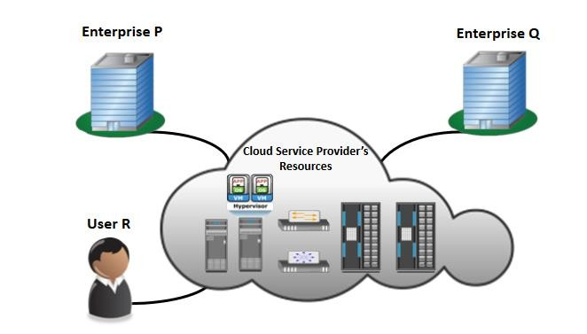
Public Cloud
Example: Amazon Elastic Compute Cloud (EC2), Microsoft Azure, IBM's Blue Cloud, and Google Cloud

Slide 53
Advantages of Public Cloud
Low Cost: Decreases capital cost as it eliminates the need to purchase physical hardware and to hire IT crew in-house.
Scalability and reliability: Public cloud offers scalable (easy to add and remove) and reliable (24*7 available) services to the users at an affordable cost.
Quickly and easily set up: Organizations can easily buy public cloud on the internet and deployed and configured it remotely through the cloud service provider within a few hours.
Maintenance:- The user can focus on development than maintenance.

Slide 54
Disadvantages of Public Cloud
Security:- The security and privacy of data present inside a Public cloud service remains a concern for many businesses.
Lack of control :- The cloud is entirely managed and supported by the service provider so businesses often have limitations of personal data control and configuration.
Vendor lock-in:- An organization that uses the cloud will save money and become more flexible, but it can also end up reliant upon the cloud vendor's services – the virtual machines, storage, applications, and technologies they provide – in order to maintain their business operations.
Performance: In the public cloud, performance depends upon the speed of internet connectivity.

Slide 55
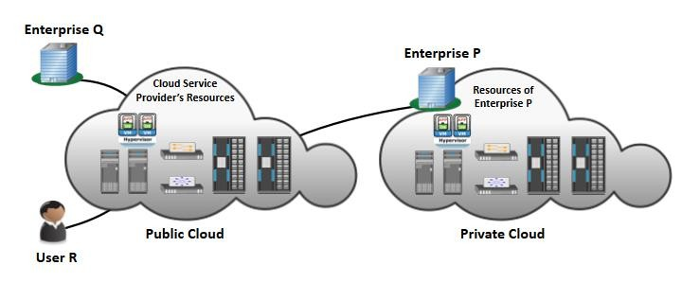
Hybrid Cloud
A Hybrid cloud deployments combine public and private clouds, and they may also include on-premises legacy infrastructure.
Almost all hybrid clouds include at least one public cloud.

Slide 56
Hybrid Cloud
Example: Hybrid Cloud
Online retailer needs more computing resources to run its Web applications during the holiday season it may attain those resources via public clouds.
An organization that wants to keep confidential information secured on their private cloud, but make more general, customer-facing content on a public cloud.

Slide 57
Advantages of Hybrid Cloud
Flexible: The hybrid cloud offers flexible resources because of the public cloud and secure resources because of the private cloud.
Scalability: A hybrid cloud delivers the same kind of dynamic scalability that public clouds allow.
Secure and reliable: Distributing resources across private and public clouds make for increased reliability and redundancy.
Cost-effective: With a hybrid cloud, users can mix and match their use of public and private cloud resources. This delivers cost effective infrastructure that is ideal for your exact usage needs.
Easy to implement: Hybrid clouds can be phased gradually into business operations for an easy transition.

Slide 58
Disadvantages of Hybrid Cloud
Integration: Use of both public and private clouds working together requires interoperability and portability of both applications and data to allow communication between the models.
Greater attack surface: A single cloud – say, a private cloud – can have strong security protections in place. But if multiple clouds from different vendors are used, not all clouds will have the same quality of security.
Complicated to secure: A company may need to use multiple security products, some for their on-premises cloud and some for their public cloud, to keep their data safe. In addition, it can be tricky to validate a user's identity across multiple clouds (access control).

Slide 59
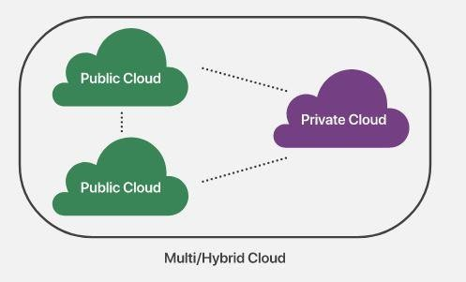
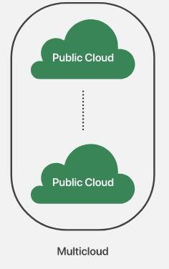
Multi Cloud
A multi-cloud deployment combines multiple public clouds, while a hybrid cloud combines a public cloud with another type of environment.
Hybrid clouds combine apples and oranges – a multi-cloud deployment is more like combining many types of apples.

Slide 60
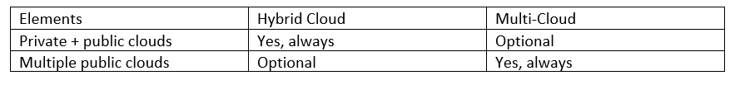
Multi Cloud
In a multi-cloud environment, an enterprise utilizes multiple public cloud services, most often from different cloud providers. For example, an organization might host its web front-end application on AWS and host its Exchange servers on Microsoft Azure.

Slide 61
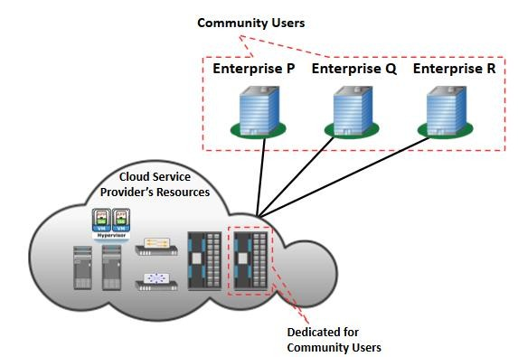
Community Cloud
Community/cooperative Cloud is a hybrid form of private cloud.
In a community cloud, a number of organizations, which usually share some common goals or belong to a specific community, build a shared cloud datacenter that can be used by all of the members.

Slide 62
Sectors that use community cloud
Media industry: Most media productions involve an extended ecosystem of partners. In particular, the creation of digital content is the outcome of a collaborative process that includes movement of large data, massive compute-intensive rendering tasks, and complex workflow executions.
Healthcare industry: In healthcare industry community clouds are used to share information and knowledge on the global level with sensitive data in the private infrastructure.
Energy and core industry: the community cloud is used to cluster set of solution which collectively addresses management, deployment, and orchestration of services and operations.
Scientific research: In this organization with common interests of science share large distributed infrastructure for scientific computing.

Slide 63
Advantages of Community Cloud
Cost effective :- Community cloud is cost effective because the whole cloud is shared between several organizations or a community.
Flexible and Scalable:- The community cloud is flexible and scalable because it is compatible with every user. It allows the users to modify the documents as per their needs and requirement.
Security:- Community cloud is more secure than the public cloud but less secure than the private cloud.
Sharing infrastructure :- Community cloud allows us to share cloud resources, infrastructure, and other capabilities among various organizations.

Slide 64
Disadvantages of Community Cloud
Community cloud is not a good choice for every organization.
The fixed amount of data storage and bandwidth is shared among all community members.
Sharing responsibilities among organizations is difficult.
High cost compared to the public deployment model.

Slide 65
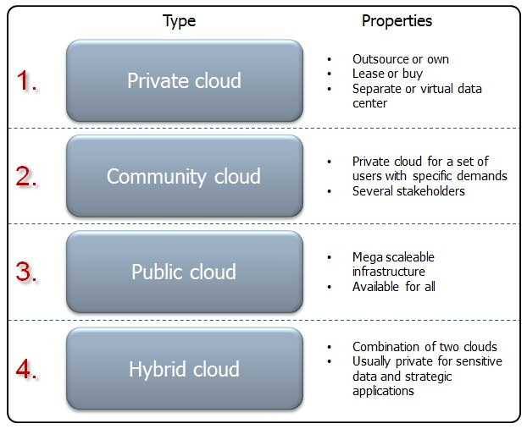
Summary: Deployment Model

Slide 66
Advantages of Cloud Computing
Easy implementation: Cloud hosting allows businesses to retain the same applications and business processes without having to deal with the backend technicalities.
Accessibility: Data access is possible anywhere, anytime, which allows easy collaboration and sharing among users in multiple locations.
No hardware required: Everything will be hosted in the cloud, so a physical storage center is no longer needed.
Cost Saving: It helps to save substantial capital costs as it does not need any physical hardware investments. Also, the need for trained personnel to maintain the hardware is reduced.

Slide 67
Advantages of Cloud Computing
Flexibility for growth: The cloud is easily scalable so companies can add or subtract resources based on their needs.
High Speed: Cloud computing allows to deploy service quickly in fewer clicks.
Back-up and restore data: Once the data is stored in a Cloud, it is easier to get the back-up and recovery of that, which is otherwise very time taking process on-premise.

Slide 68
Disadvantages of Cloud Computing
No longer in control: When moving services to the cloud, user loses control over data.
Performance Can Vary: Any attack on your tenant could affect the performance of your shared resource.
Internet Connectivity: Good Internet connectivity is a must in cloud computing.
Security: The company's sensitive information stored in a cloud service provider is prone to attack.

Slide 69
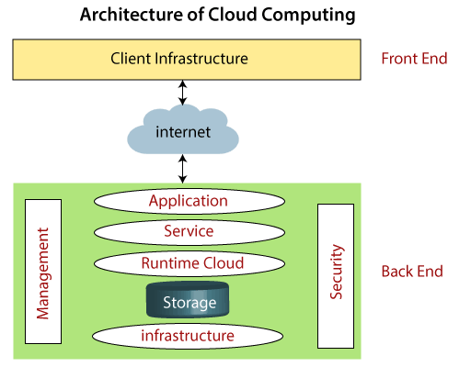
Cloud Computing Architecture
Components of Cloud Computing Architecture
  Client Infrastructure
  Application
  Service
  Runtime Cloud
  Storage
  Infrastructure
  Management
  Security
  Internet

Slide 70
How does cloud computing work?
Cloud Computing are divided into two section
Front end
Back end
The front end is the side of the computer user or client
The back end is ‘the cloud’ section of the system.

Slide 71
Cloud Computing Threats
1. Data Breach
2. Account Hijacking
3. Insecure APIs
4. Misconfiguration
5. Malicious Insider
6. Denial of Service (DoS/DDoS)
7. Loss of Data
8. Abuse of Cloud Services
9. Shared Technology Vulnerabilities

Slide 72
Limitations of Cloud Computing
No user Full control
Internet dependency
Data privacy & security concerns
Vendor lock-in
Outages risk

Slide 73
Characteristics of Cloud Computing
On-demand self service
Broad Network Access
Resource Pooling (Multi-Tenancy)
Rapid Elasticity (Scalability)
Measured Service (Pay-as-you-use)
Virtualization Technology

Slide 74
Thankyou

